Slide 1
Identified Issues with KWH Website
2024-10-07
https://kwh.9u1.net/

Slide 2
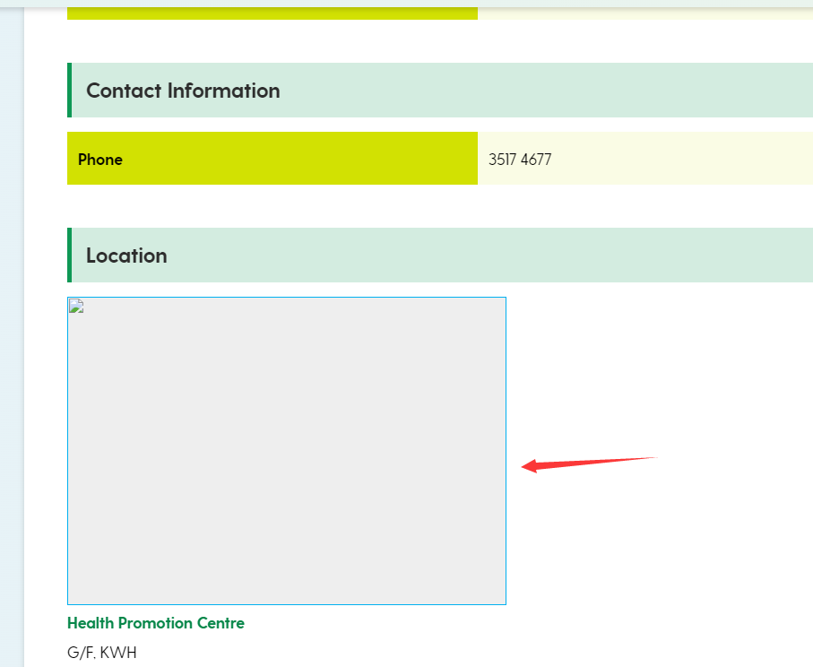
https://kwh.9u1.net/Services/Health-Promotion-Centre.html#shadowBox217 請提供圖片

Slide 3
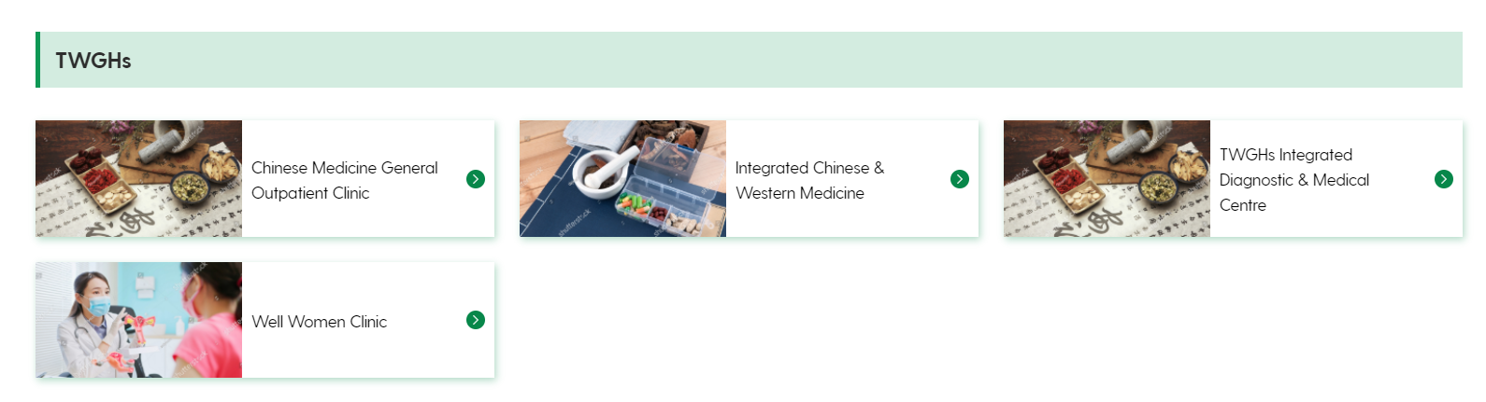
https://kwh.9u1.net/Our-Services.html?lang=en 水印圖片有待確應

Slide 4
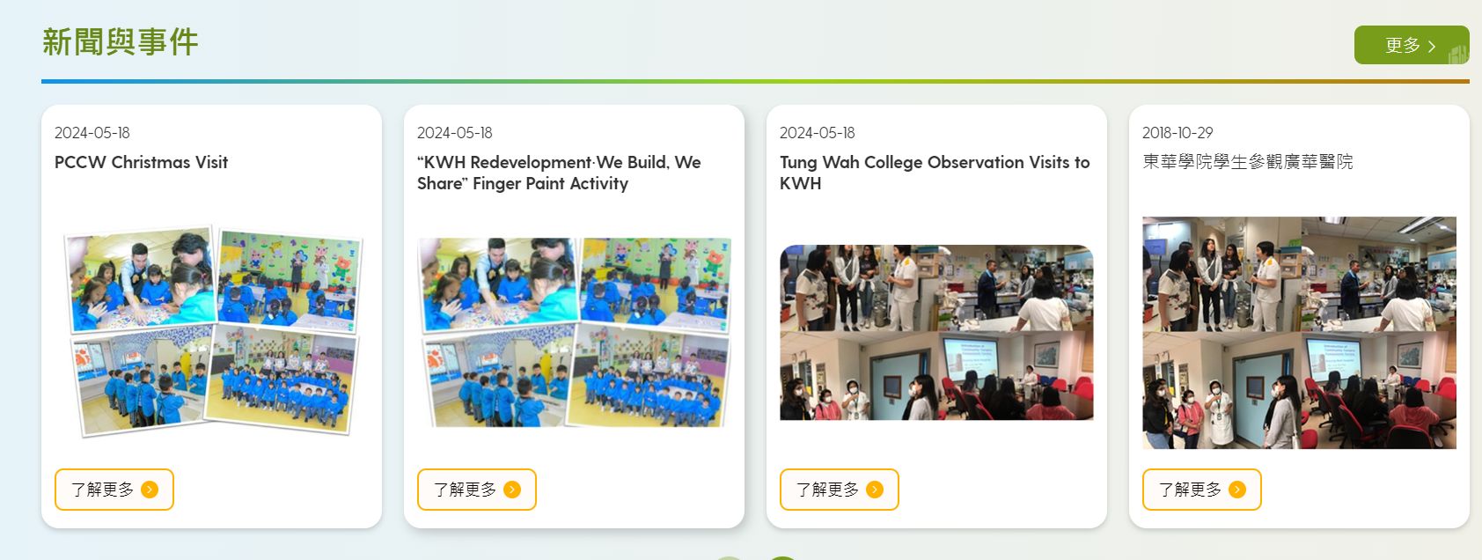
https://kwh.9u1.net/index.html 之前一直未有討論的頁面

Slide 5
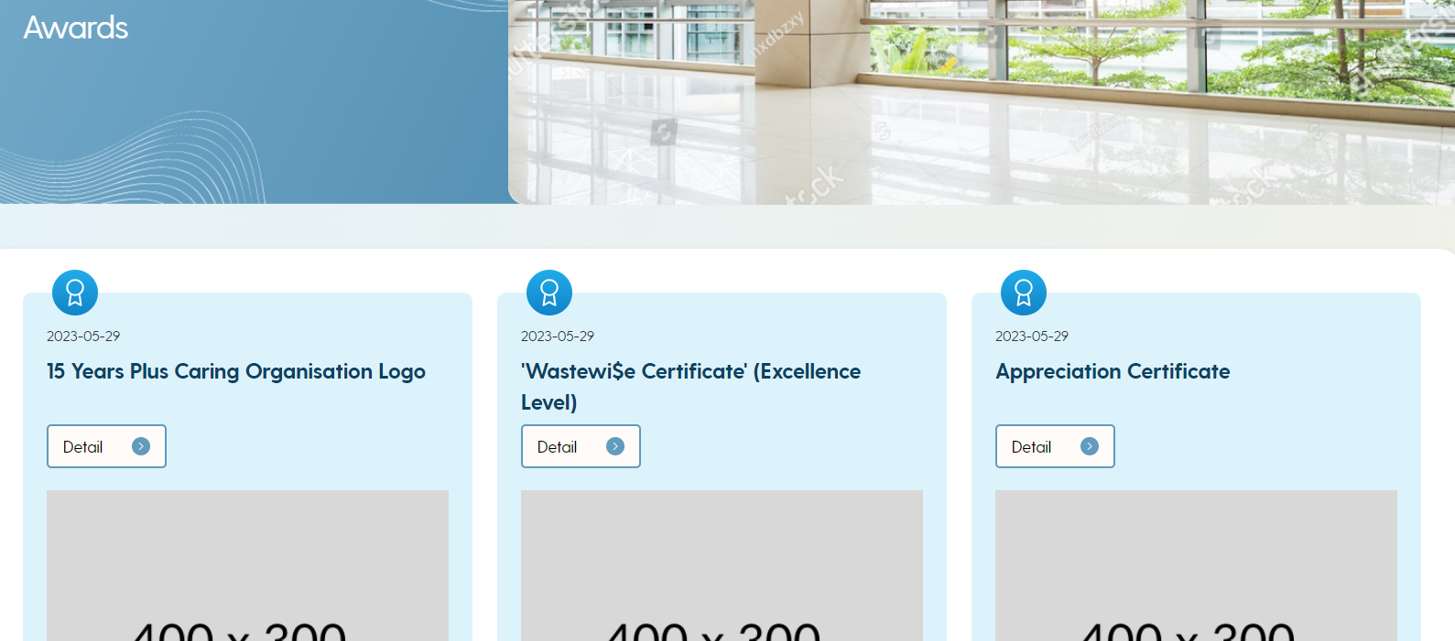
https://kwh.9u1.net/Awards.html 之前一直未有討論的頁面

Slide 6
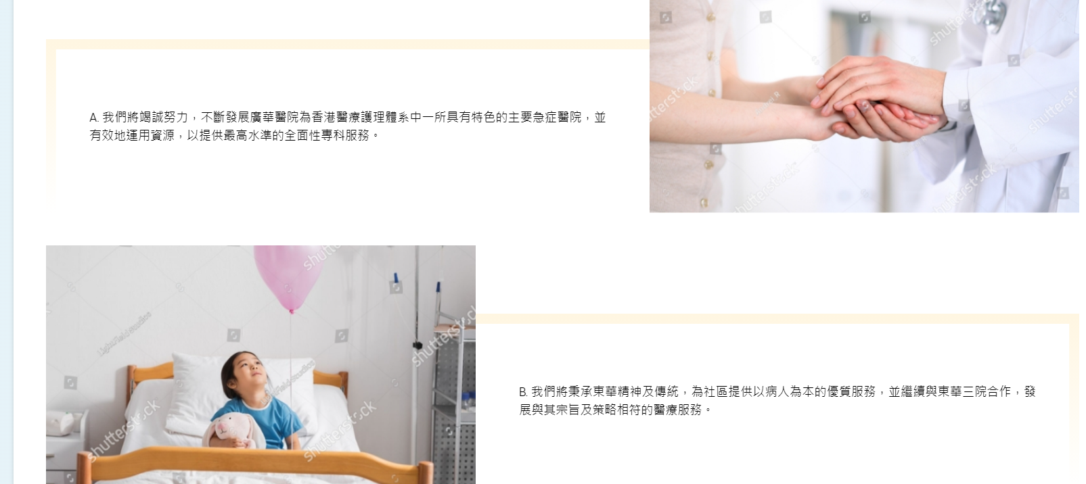
https://kwh.9u1.net/Mission.html 水印圖片有待確應

Slide 7
以下的頁面的英文內容是否最終版本, 可安排翻譯中文文字?
https://kwh.9u1.net/Specialist-Out-patient.html
https://kwh.9u1.net/General-Out-patient.html
https://kwh.9u1.net/Redevelopment-Project.html

